Slide 1
The Common Ground of Music
THE DEATH OF ROMANTICISM

Slide 2
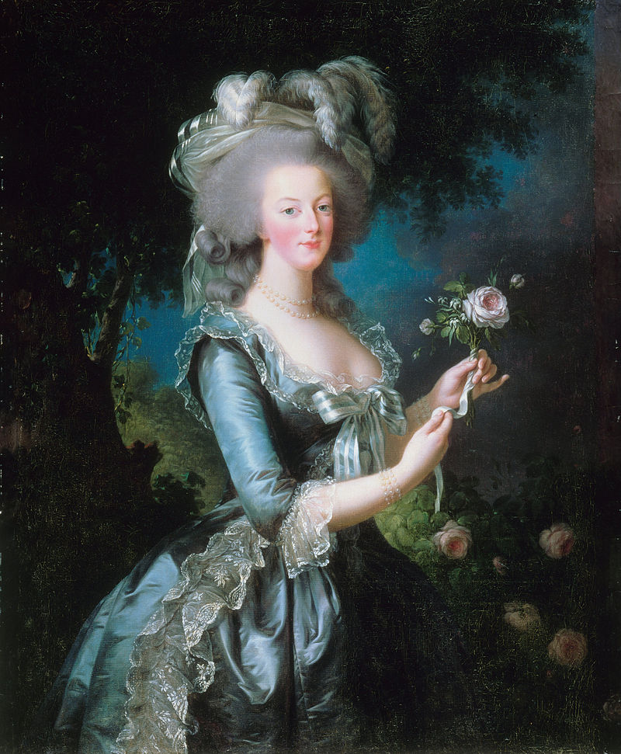
ThE Queen’s Jolly Good Baby
● Louis XVII of France was born in 1785
● His Nurse Madame Poitrine Sang to him :
The Death and Burial of the Invincible Marlbrough
Listen to the song in the original French

Slide 3
The Lyrics
"But since to speak I'm hurried,"
Added this page, quite flurried,
"Malbrook is dead and buried!"
And here he shed a tear.
"He's dead! He's dead as a herring!
For I beheld his berring,
And four officers transferring
His corpse away from the field.
"One officer carried his sabre,
And he carried it not without labour,
Much envying his next neighbour,
Who only bore a shield.
"The third was helmet bearer -
That helmet which in its wearer
Fill'd all who saw it with terror,
And cover'd a hero's brains.
"Now, having got so far, I
Find that – by the Lord Harry!-
The fourth is left nothing to carry.-
So there the thing remains."
Mironton, mironton, mirontaine.
Marlbrook the Prince of Commanders
Is gone to war in Flanders,
His fame is like Alexander's,
But when will he ever come home?
Mironton, mironton, mirontaine.
Milady in her watch-tower
Spends many a pensive hour,
Not knowing why or how her
Dear lord from England stays.
While sitting quite forlorn in
That tower, she spies returning
A page clad in deep mourning,
With fainting steps and slow.
"O page, prithee come faster!
What news do you bring of your master?
I fear there is some disaster,
Your looks are so full of woe."
"The news I bring fair lady,"
With sorrowful accent said he,
"Is one you are not ready
So soon, alas! to hear.
.

Slide 4
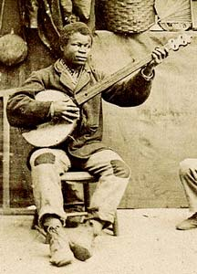
Captain Thomas Phillips’ Legacy
● 1683 – too many slaves died in transit
● Forced the slaves to dance or be whipped
● Decided to allow African instruments
● The “banjar” arrived in the colonies

Slide 5
Impressionistic Music
THE DEATH OF ROMANTICISM
c.a. 1875 - 1925
"I love music passionately. And because I love it, I try to free it from barren
traditions that stifle it. It is a free art gushing forth, an open-air art boundless
as the elements, the wind, the sky, the sea. It must never be shut in and
become an academic art."
Claude Debussy

Slide 6
Goals
Set the cultural context of the period
Hear the tools used by composers of impressionistic music
Learn about Debussy’s life and music
Learn about Ravel’s life and music
Listen to two masterworks of the period
Explore the legacy of impressionistic music

Slide 7
Western classical music Periods
Medieval c. 500 – 1400
Renaissance c. 1400 –1 600
Common practice
Baroque c. 1600 – 1750
Galante c. 1720 – 1770
Classical c. 1770 – 1820
Romantic c. 1815 – 1910
Impressionists c. 1885-1925
Modern and contemporary
Modern c. 1890 – 1930
20th century 1901 – 2000
Contemporary c. 1975 – present
21st century 2001 – present

Slide 8
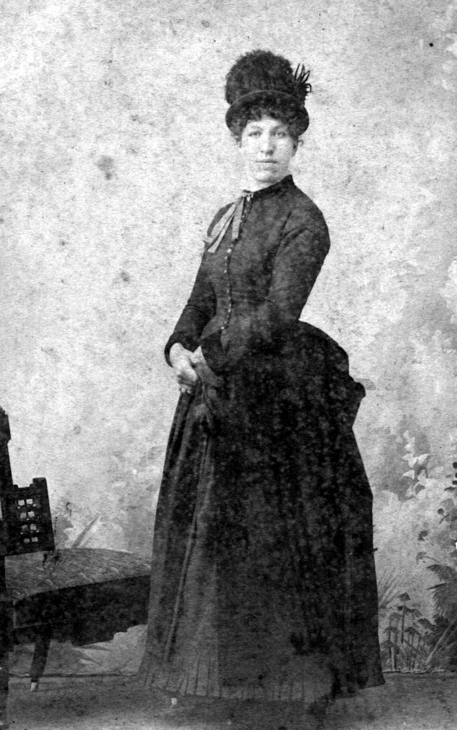
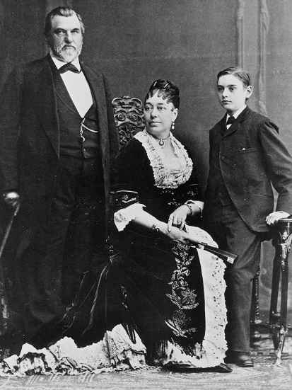
Cultural context
1885
A fast horse will travel about 40 mph for several miles
Women’s skirts reach the ground – the bustle going out of style
Men of business wear frock coats, stiff detachable collars, loose ties
Most ships are powered by wind
Electricity is a novelty
No movies.. no cars…no radio…
Pasteur creates a vaccination for rabies
Karl Benz builds a three wheel automobile
Gottlieb Daimler invents the motorcycle
Lord Rayleigh identifies earthquake waves
George Eastman patents production of continuous photographic film
James Dewar invents the thermos bottle
The game of golf is introduced to USA
Indoor plumbing installed in the white house
Hear Alexander Graham Bell speak

Slide 9
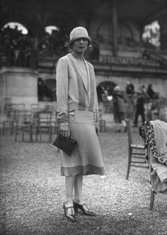
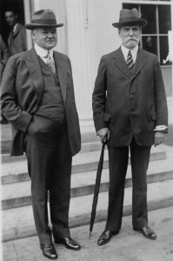
Cultural context
1925
The land speed record is 150.86 mph
Hemlines approach the knee
Men of business wear contemporary suites and soft collars
Most ships are powered by steam
Air mail service is growing
Electricity is an integral part of all major cities
Color TV is patented
Chrysler Motor Company founded
Charleston becomes the popular dance
Scopes trial about evolution
Hitler publishes Mein Kamp
F. Scott Fitzgerald publishes the Great Gatsby
Ben-Hur movie grosses $9 million

Slide 10
40 Years of Change
1886 Fran Liszt dies
1887 The contact lens in invented
1888 Henrich Hertz produces and detects radio waves
1889 Eiffel Tower opens
1890 Rubber gloves used during surgery 1st time (Johns Hopkins)…. Eisenhower born
1891 Conan Doyle publishes the first Sherlock Holmes story
1892 Leoncavallo premiers I Paliacci
1893 Rudolf Diesel invents the Diesel engine
1894 Nicholas II becomes Tsar of all the Russias and Nikita Krushev is born
1895 King Gillett introduces the safety razor
1896 Tabulating Machine Company founded – later changes its name to IBM
1897 H.G. Wells write The Invisible Man
1898 US declares war on Spain over Cuba
1899 First magnetic recording of sound
1920 Retired U.S. Army officer John T. Thompson invents The Tommy Gun
1921 KDKA, Pittsburg transmits first regular radio programs in USA
Playwright Karl Capek coins the term robot to describe mechanical people in his play RUR
1922 Mussolini forms Fascist government
1923 Sound motion pictures are demonstrated by Lee D Forest
1924 Kleenex (celluwipes) are introduced
1900 1st off shore oil wells are drilled
1901 J. P. Morgan organizes U.S. Steel and Panama Canal Treaty ratified
1902 Ivan Petrovich Pavlov formulates his law of reinforcement - Animal Crackers go on sale
Willis Carrier invents the air conditioner
1903 Wright Brothers conduct the first successful controlled flight of an airplane
1904 Safety Glass is patented
1905 Einstein's Theory of Special Relativity …..Dial telephone invented
1906 Aubrey Fessenden invents AM radio and transmits music and voice via radio waves
1907 First exhibition of Cubist visual art in Paris
1908 Cellophane is invented
1909 General Electric markets the world’s first electric toaster
1910 Neon light invented
1911 worlds first escalator
1912 5 million people daily attend a movie in the USA
1913 Worlds first home refrigerator goes on sale in Chicago
1914 Robert Goddard begins experimenting with rockets Typewriter is invented
1915 First transcontinental phone call – New York to San Francisco Bell to Watson
1916 Washing machine invented
1917 Allies execute Mata Hari as a spy…. JFK born
1918 8.5 million die in WWI and 22 million die of the “Spanish flu”
1919 African-American band leader Lieutenant James Europe brings Jazz to Europe

Slide 11
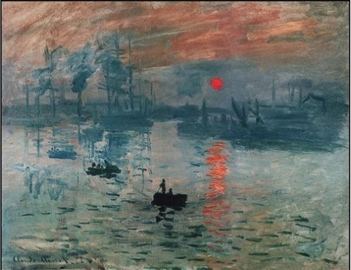
Impression: soleil levant
1872 - Monet painted this picture of the sun seen through mist at the harbor of Le Havre
1874 The painting was catalogued as Impression: soleil levant in the first exhibition
1877 - Art critic Louis Leroy of Le Charivari wrote a scathing, scoffing article on the exhibition in which he coined the word Impressionnistes as a general description of the exhibiting artists The term was first used by the artists themselves for their third group exhibition in 1877.

Slide 12
Music sings the themes of the times
Ambiguity
Uncertainty
Dissonance
Ambivalence
Lack of resolution
Missing or imperceptible rhythms

Slide 13
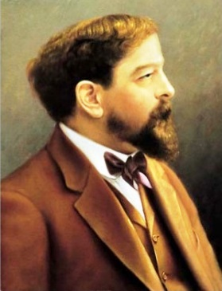

Slide 14
Debussy timeline - Birth through School
1862 Achille-Claude Debussy is born.
Father Manuel Debussy takes part in the Paris Commune. After the Commune is defeated, he
is sentenced to four years in prison.
1874 age 12, enrolls at the Paris Conservatory of Music. Debussy's piano examination inspires the
following comment from his teacher Marmontel:
“Charming child, true temperament of an artist; will become a distinguished musician; a great future.”
1884 Leaves the Paris Conservatory of Music at age 22

Slide 15
Debussy timeline - 1889 - 1905
1889 Universal Exhibition in Paris – Debussy discovers the Javanese gamelan performed
by musicians from Saigon, Vietnam
1894 First performance of Prélude à l'après-midi d'un faune
1899 Debussy marries Lilly Texier
Debussy begins a love affair with Emma Bardac, wife of a banker.
Lilly Debussy attempts suicide by shooting herself in the stomach with a revolver.
Divorce for both Debussy and Bardac. Most friends abandon Debussy.
Le Mer is premiered. Claude-Emma Debussy ( Chou Chou) is born to the
Recently married couple

Slide 16
Debussy timeline - 1909 - 1918
1909 Diagnosed with colorectal caner.
Debussy undergoes one of the first colostomy operations.
Working on an opera based upon Poe’s story The Fall of the House of Usher
Lilly Texier takes Debussy to court for unpaid alimony.
He has not paid alimony since 1910.
Money and health problems begin to overwhelm him.
1918 Debussy dies of colorectal cancer

Slide 17
Tools of the Impressionists
Whole tone scale
Modes of the scale
Influences beyond Europe
Harmonic ambiguity
Ambivalence
Emotion and perceptual experiences SUPPLANT program music
View and hear a Gamelan from Indonesia

Slide 18
Language of the Impressionists
Name | Scale | Orchestration
Ionian
Dorian
Phrygian
Lydian
Mixolydian
Aeolian
Locrian
Whole Tone
The 9th
Notes:
The whole tone scale has no leading tone and because all tones are the same distance apart,
"no single tone stands out, and the scale creates a blurred, indistinct effect".
This effect is especially emphasized by the fact that triads built on such scale tones are augmented.
Indeed, one can play all six tones of a whole tone scale simply with two augmented triads
whose roots are a major second apart.
Since they are symmetrical, whole tone scales do not give a strong impression
the tonic or tonality.

Slide 19
Music of the Impressionists – Listen For:
Irregular phrases
Traditional harmonic progressions are avoided
The color of the orchestra is veiled – a blur – a mystery
The form of Impressionistic music is at best ambiguous
Dissonances remain unresolved
Whole-tone scales, use of 9th chords, modality, exotic scales, vague rhythm

Slide 20
I am Not an Impressionist
In a letter dated 1908, Debussy wrote:
"I am trying to do 'something different'—an effect of reality ... what the imbeciles call 'impressionism', a term which is as poorly used as possible, particularly by the critics, since they do not hesitate to apply it to [J.M.W.] Turner, the finest creator of mysterious effects in all the world of art.“
(J. M. W. Turner 1775-1851 British Landscape artist of the Romantic period)
See some of J.M.W. Turner’s art here

Slide 21
Hallmarks of Debussy’s Music
Glittering passages and webs of figurations
distractions from occasional absence of tonality
Frequent use of parallel chords
not harmonies at all, but rather 'chordal melodies', enriched unisons
Bitonality
music orchestrated in two keys simultaneously
Whole-tone and pentatonic scales
Instability and softness within ambiguous settings
Jolting changes of key
without any harmonic preparation or bridge
A Sense of Play
Spontaneity – no way to predict what will come next
Provisional Reality – nothing permanent - nothing predictable

Slide 22
La Mer - 1905
2 flutes and piccolo,
2 oboes and cor anglais (English horn)
2 clarinets, 3 bassoons and contrabassoon,
4 horns
3 trumpets and 2 cornets
3 trombones and tuba
timpani, cymbals, tam-tam, triangle,
glockenspiel, bass drum,
2 harps, and strings.
Performance time is approximately twenty-three minutes.
Debussy told Stravinsky, that in rehearsals for the premier, the violinists tied handkerchiefs to the tips of their bows in protest against music they thought offensive
When the score of Le Mer was printed, Debussy insisted that the cover include a detail from
The Hollow of the Wave off Kanagawa, the most celebrated print by the Japanese artist Hokusai,
then enormously popular in France.

Slide 23
La Mer – Observations by Composers
Debussy: I have an endless store of memories [that] are worth more than the reality, whose beauty often deadens thought.
Debussy felt overwhelmed in the presence of the sea and could not compose within sight or sound of it.
Pierre Boulez : an infinitely flexible conception of acoustical instrumental relationships that avoided symmetry, …..a development conceived in feelings and irreducible to a formal classical plan.
Saint-Saëns : Debussy has not created a style but has cultivated the absence of style.
Boulez: What was overthrown was not so much the art of development as the very concept of form itself, … giving wings to a supple, mobile expressiveness, … a miracle of proportion, balance and transparency.
Debussy
There is no theory. You merely have to listen. Pleasure is the law.

Slide 24
Le Mer – The Musicologists Weigh In
Simon Trezise, Debussy: La Mer (Cambridge, 1994)
Motifs are constantly propagated by derivation from earlier motifs.
Jean Barraqué (La Mer de Debussy, Analyse musicale)
La Mer was the first work to have an "open" form - a "sonorous becoming... a developmental
process in which the very notions of exposition and development coexist in an uninterrupted burst."
Roy Howat ,Debussy in Proportion
The formal boundaries of La Mer correspond exactly to the mathematical ratios called The
Golden Section or the Fibonacci number.
Structuring a composition around a nature subject without any literary or human element to it –
no people, no mythology, no ships are suggested in the piece - was highly unusual at the time.

Slide 25
Le Mer – 3 Movements – 3 Evocations
It is impossible to assign a specific program to the structure of Le Mer.
This frustrated music critics and musicians of the time who expected schematic literalism.
This style of predictability drove the popularity the tone poems of the time.
Thus, the shimmering, vibrant, imposing climax of the first movement could just as easily be a
stiff breeze, clouds dispersing, sun penetrating the depths, or the appearance of a great ship.
1. Inchoate, formless, incoherent mystery (From Dawn ‘til Noon)
2. Lively motion
3. Interaction of powerful forces.
Hear and view a color-coded real-time analysis of La Mer
25 minutes long – the next sides refer to the three movements in this link

Slide 26
Le Mer – 1st Movement
From Dawn to Noon on the Sea
The subject matter is:
color
texture
nuance
The experience of hearing the movement is morning on the sea is:
inchoate
formless
incoherent
mysterious

Slide 27
Le Mer – 2nd Movement
Play of the Waves
Lively Motion
The structure of Le Mer
two powerful movements framing a scherzo
Scherzo
Italian for “joke”.
a fast-moving humorous composition

Slide 28
Le Mer – 3rd Movement
Dialogue of the wind and the sea
interplay of powerful forces
Some passages, especially in the 3rd movement, of La Mer are though to have inspired
John Williams in composing the score he wrote for Jaws (1975).

Slide 29
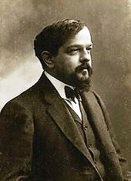
The Critics Decide
The New York critics found Le Mer . . . .
a putrefied mud-puddle
unintelligible
persistently ugly
bewildering chaos
a dissonant jumble
the dreariest kind of rubbish
A Boston critic wrote:
Le Mer should be titled "Mal de Mer" ("Seasick"), with its
movements devoted to: Headache, Doubt and Nausea.
Debussy responded to one critic:
“You love and defend traditions that no longer exist for me. . . .
The dust of the past is not always to be respected.

Slide 30
Debussy said his major influences were:
Bach's tracing and ornamenting of musical lines rather than melodic focus.
“Infinite arabesques" and complex counterpoint of the Javanese gamelan
Chopin’s grace, suppleness and extended harmonic range
The artful stylization of nature that appear in Japanese landscape prints
The oriental influences of Russian composers
(he spent two summers tutoring the children of Tchaikovsky's patron, Mme. Van Meck).
Mussorgsky’s spontaneity and freedom from arid formulas
Debussy on Mussorgsky - "successive minute touches mysteriously linked together by
means of an instinctive clairvoyance."
Richard Strauss's structures of orchestral color

Slide 31
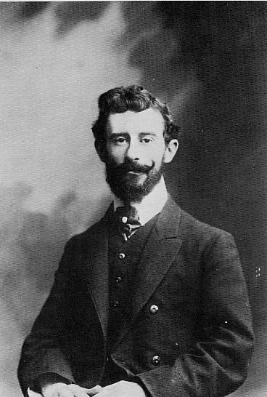
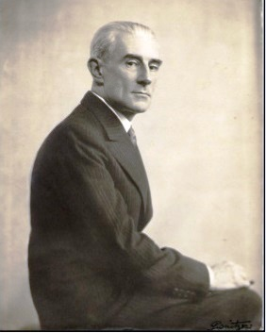
Joseph-Maurice Ravel
1906
ca 1935

Slide 32
Joseph-Maurice Ravel March 7, 1875 – December 28, 1937
Ravel was very fond of his mother - her Basque-Spanish heritage was a profound influence
on his life and music. Father a Swiss engineer
1881 Age six, begins piano lessons and instruction in harmony, counterpoint, and composition
1889 Age 14 enters Paris Conservatoire. Studied composition with composer Gabriel Faure.
Age 20 Ravel was expelled from the Paris Conservatoire for failing to meet the requirement
of earning a competitive medal in three consecutive years.
1900, Ravel invited to Debussy’s home and they played each other’s works.
They become close friends
1909 Begins composing his masterwork Daphnis and Chloe

Slide 33
Joseph-Maurice Ravel March 7, 1875 – December 28, 1937
1912 Premier of Daphnis and Chloe. Ravel suffers a breakdown from the exhausting work and
conflict with Sergei Diaghilev and Vaslav Nijinsky. He is diagnosed with “Americanitis”
Post The Great War – Ravel introduces jazz techniques to art music – c.f. George Gershwin
1922 Orchestrates Modest Mussorgsky’s Pictures at an Exhibition.
1928 Bolero Premiers
1932 Ravel suffered a serious head injury during a taxi accident. He began to experience
aphasia-like symptoms and was frequently absent-minded.
Age 62, Ravel consented to experimental brain surgery. When he awoke from the anesthesia,
he asked for his brother, but quickly sank into a deep coma, from which he never awoke.

Slide 34
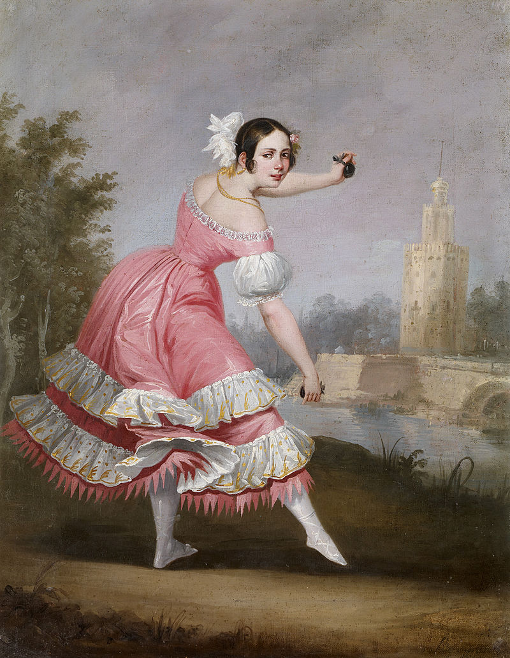
Bolero Form
Bolero is a Spanish dance
Dancer Sebastiano Carezo is credited with inventing the dance
in 1780.
For soloist or a couple…… played at a slow tempo
Castanets and guitars support the lyrics
Quatrain form lyrics of five to seven syllables .
Usually written is in triple time (3|4)
Usually has a triplet on the second beat of each bar.
Ravel’s interest in the bolero form must derive from his Mother’s
Basque-Spanish heritage and her love of folk melodies

Slide 35
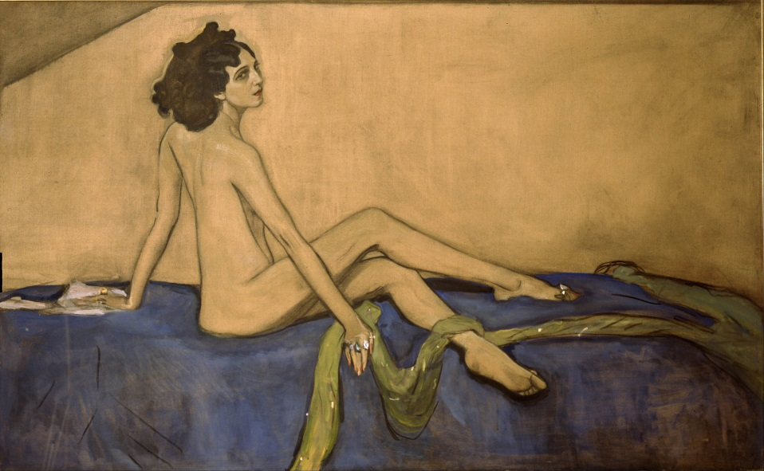
Bolero - 1928
Originally composed as a ballet commissioned by Russian actress and dancer Ida Rubinstein.
The original title was Fandango
Ravel on his composition Bolero
An experiment in a very special and
limited direction
I am going to try to repeat it a number of
times on different orchestral levels but
without any development.
It has no music in it
Arturo Toscanini conducted Bolero at a faster tempo and with an “accelerando at the finish”.
Ravel was not happy about the changes:
I don’t ask for my music to be interpreted, but only that it should be played.

Slide 36
Ravel’s Great Skill - Orchestration
Orchestration is the practice of adapting music for an orchestra . The work might have been originally conceived of as an orchestral piece or it may have been written for small ensemble or solo player.
Pictures at an Exhibition
Modest Mussorgsky 1874
Piano Solo
Pictures at an Exhibition
Ravel’s 1928 Orchestration

Slide 37
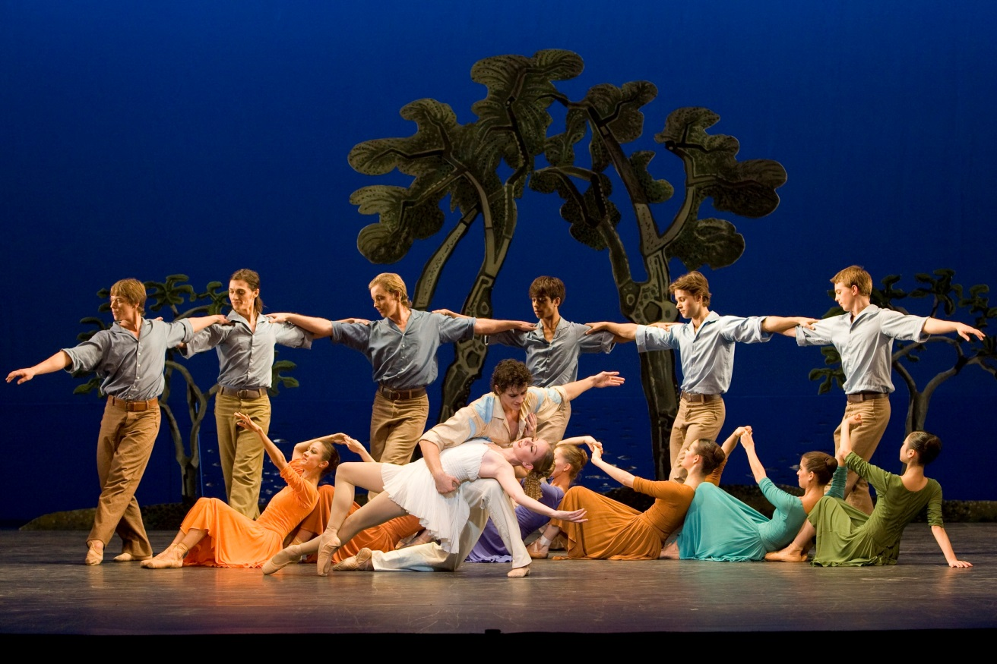
Daphnis and Chloe - 1912
Ravel’s Masterwork and his
longest work - about 1 hour
Commissioned by Sergei Diaghileff,
director of the Russian Ballet.
The ballet is based on the Greek
legend of Daphnis and Chloe
Ravel extracted music from the ballet to make two orchestral suites .

Slide 38
Daphnis and Chloe – the story
Two infants abandoned at birth.
A goatherd named Lamon discovers Daphnis, and a shepherd called Dryas finds Chloe.
Each raises the child as his own. Daphnis and Chloe grow up together, herding
flocks for their foster parents.
They fall in love but do not understand what is happening to them.
A wise old cowherd, explains to them what love is and tells them that the only cure is "kissing."
Lycaenion, a woman explains love-making to Daphnis
Lycaenion warns Daphnis that Chloe "will scream and cry and lie bleeding heavily as if murdered.“
Chloe is courted and carried off by raiders and saved by the intervention of the god Pan.
Daphnis falls into a pit, gets beaten up, is abducted by pirates, and is very nearly raped.
In the end, Daphnis and Chloe are reunited with their birth parents, get married,
and live out their lives in the country.

Slide 39
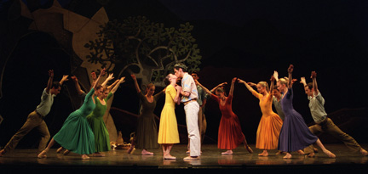
Daphnis and Chloe Suite No. 2
Lever de jour
6 minutes
Pantomime
Les amours de Pan et Syrinx
5 minutes
Danse Générale
Bacchanale
4 minutes

Slide 40
Capitalists Take Ravel’s Music
Ravel's works entered the public domain in December 1987 (USA) or January 1, 2008 (EU).
The composer’s will left everything to his brother Edouard.
1954 Edouard was severely injured in a car accident in 1954 and required near constant care.
1957 Edouard announced his intention to deed 80% of the composer's posthumous royalties to the
city of Paris and endow a Nobel Prize in music. HOWEVER, Edouard consigned the rights to his
nurse and chauffeur.
1960, the Ravel estate is litigated for a decade.
Jean-Jacques Lemoine, the legal director of SACEM froze distribution of Ravel's account.
When the litigation ended Lemoine resigned from SACEM and set up a shell company, Arima,
for collecting Ravel's royalties. The company is based in Gibraltar and the British Virgin
Islands in order to avoid French taxes.
Arima sued Ravel's publisher to re-write the original contracts, consigning a greater percentage of the
royalties to Arima than Durand's publisher.

Slide 41
Capitalists Take Ravel’s Music
Arima has collected at least £30m.
None of assets or income from Ravel's musical estate
has gone to the Ravel family or
to further the cause of
French music.

Slide 42
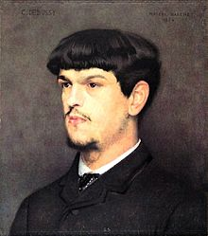
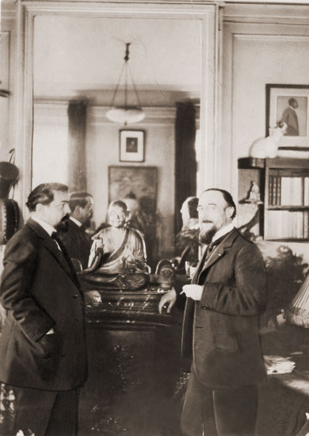
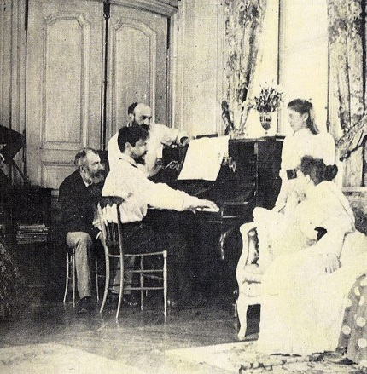
Some Prominent Composers of the Period
Claude Debussy
Maurice Ravel
Isaac Albéniz,
Frederick Delius
Paul Dukas
Manuel de Falla
Gabriel Fauré
Gershwin
Charles Griffes
Ottavino Resphigi
Erik Satie
Alexander Scriabin
Igor Stravinsky
Karol Szymanowski
Prokofiev
Shostakovitch
Ralph Vaughan Williams

Slide 43
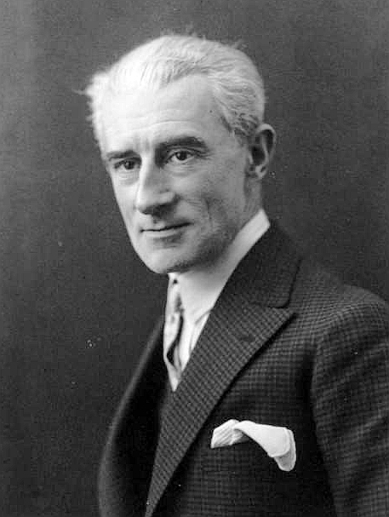
Legacy of the Impressionists
The Impressionist musical language, techniques, and aesthetic had a direct and profound
influence on the revolutionary Modern period that followed.
Find their art in jazz, music of the movies, and throughout the 20th century
search for new, ephemeral means to express musical ideas.

Slide 44
Where did the Impressionists lead Us?
To the Movies
 Max Steiner Fled NAZIs - applied his musical genius to Hollywood
 He scored more than 300 films during his American career – Casablanca, Gone with the Wind, A Summer Place, The Searchers, Sgt. York,
 He brought the operatic technique of leitmotif to film
 He was the first composer to synchronize motion & music on screen
 He merged the storytelling of Romanticism with the color of Impressionism to create the film composer’s art that is still used today
See the first synchronization of an actor’s movements with music in this
sequence from King Kong 1933.
Start at 17:00 - End at 17:40

Slide 45
Music DID fall Apart in the Early 20th Century
 1911 Igor Stravinsky composes music for the ballet The Rite of Spring
 The Story was old but the music was full on 20th anxiety
 Stravinsky's score contains many novel features for its time, including experiments in tonality, metre, rhythm, stress and dissonance.
 Analysts have noted in the score a significant grounding in Russian folk music, a relationship Stravinsky tended to deny. The music has influenced many of the 20th-century's leading composers and is one of the most recorded works in the classical repertoire.
wikipedia
Listen to The Rite of Spring

