Slide 1
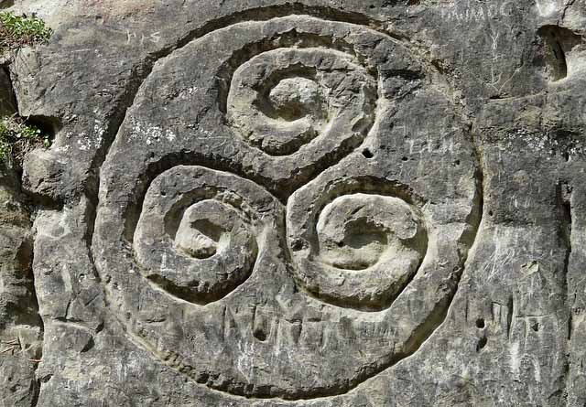
The Celts
Music – Myths - Mayhem

Slide 2
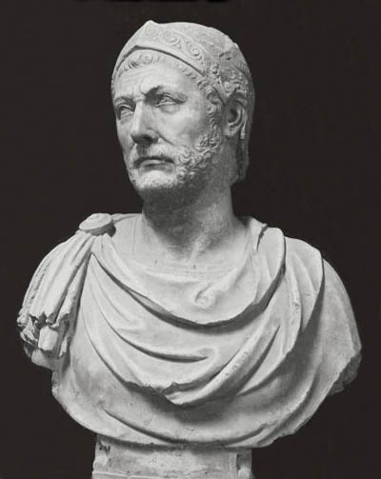
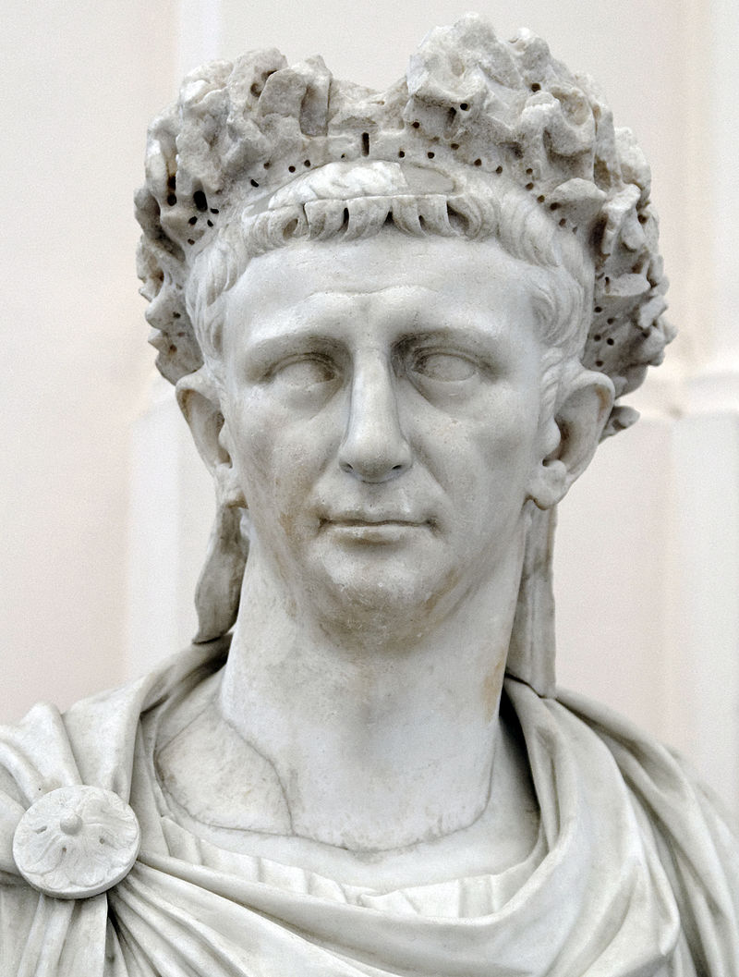
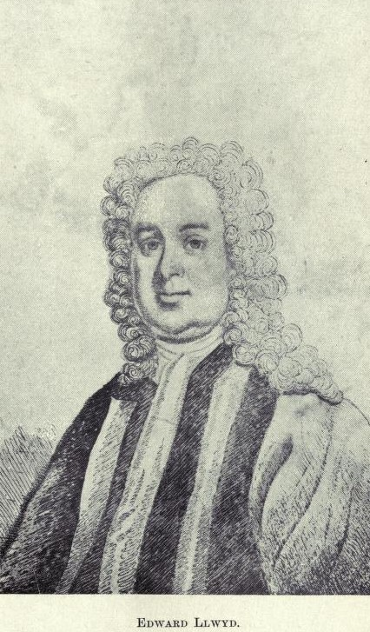
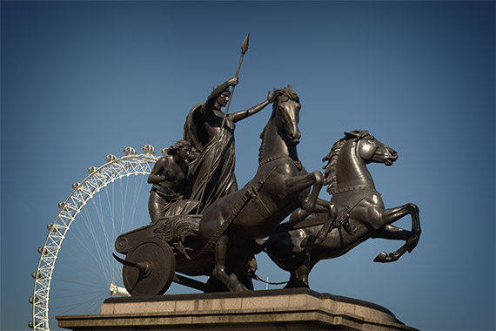
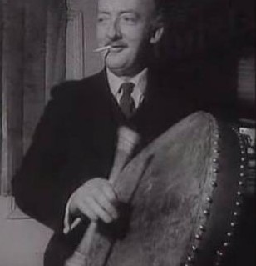
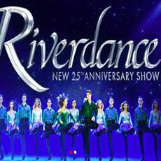
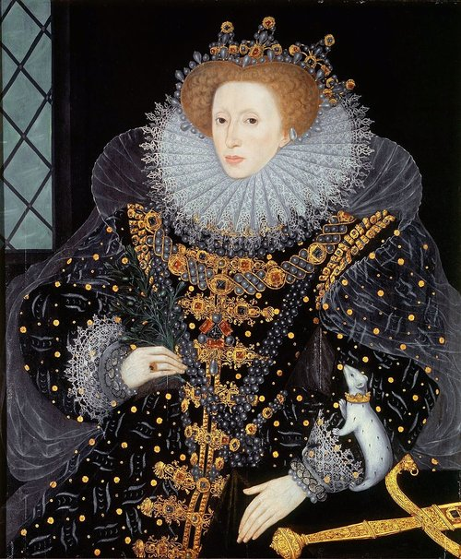
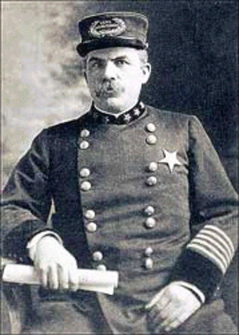
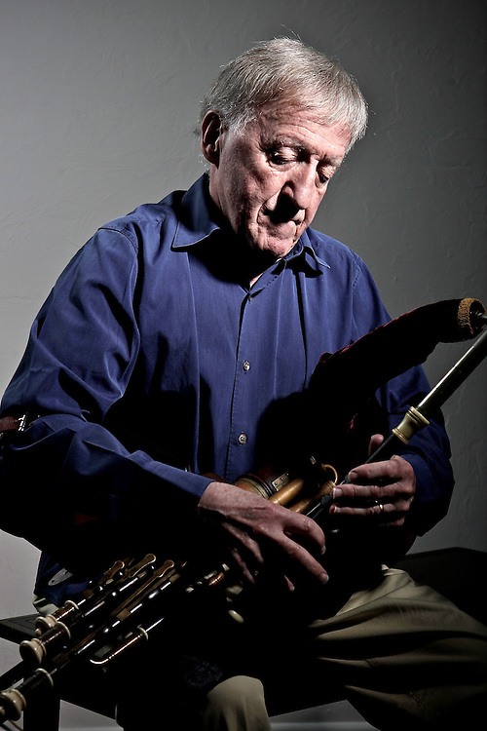
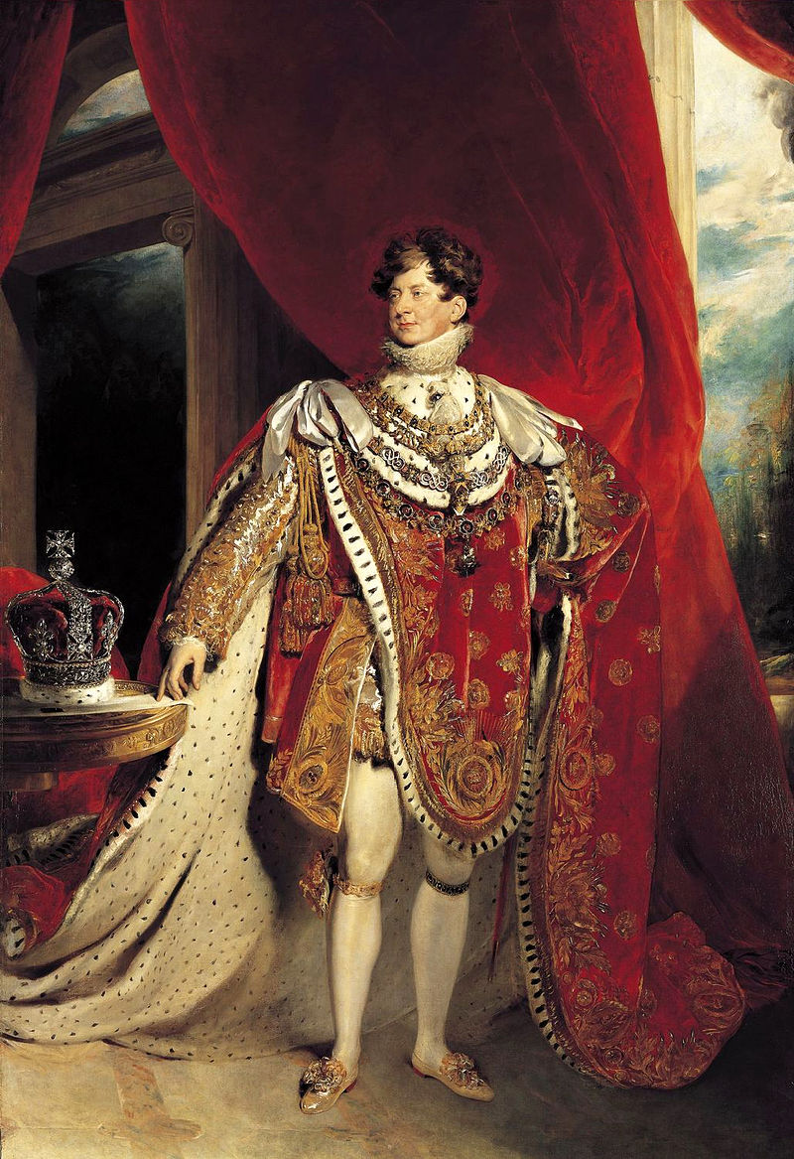
The Players

Slide 3
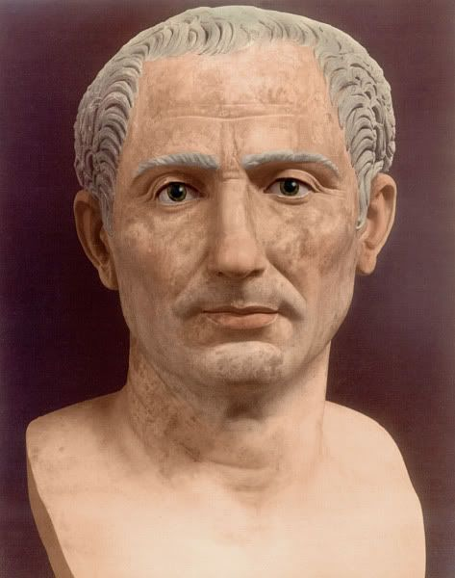
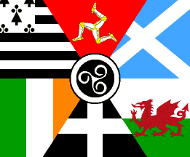
Three Phases of Celts
Ancient – Medieval Celts
???? BCE – 1707 CE
Modern Celts
1707 - 2020
Political Celts
1903 and beyond

Slide 4
Who Were the Celts of Antiquity?
The Celts were an Indo-European people in Iron Age and Medieval Europe who spoke Celtic languages and had cultural similarities, although the relationship between ethnic, linguistic and cultural factors in the Celtic world remains uncertain and controversial.
Wikipedia
Greek and Roman writers of antiquity always described the Celts as “barbarians”
The Celts appear in the writings of approximately
twenty-five Greek and Roman authors.
Native American cultures are a parallel construct
Common Language Family
Cultural similarities.
Distinct regional and tribal differences

Slide 5
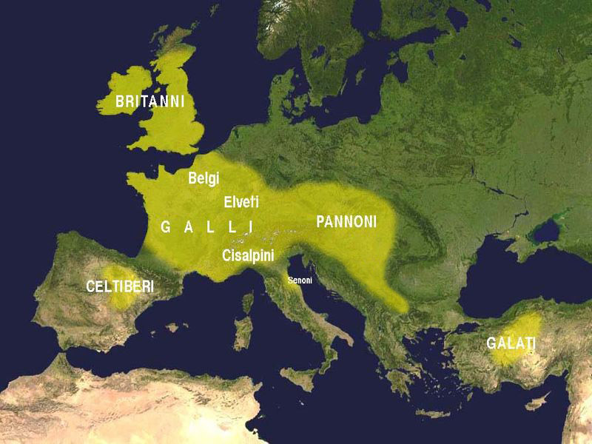
Where Were the Celts of Antiquity?
Map depicting Celtic populations in 3rd Century BCE. Created by Iron Age Scholar Francisco Villar

Slide 6
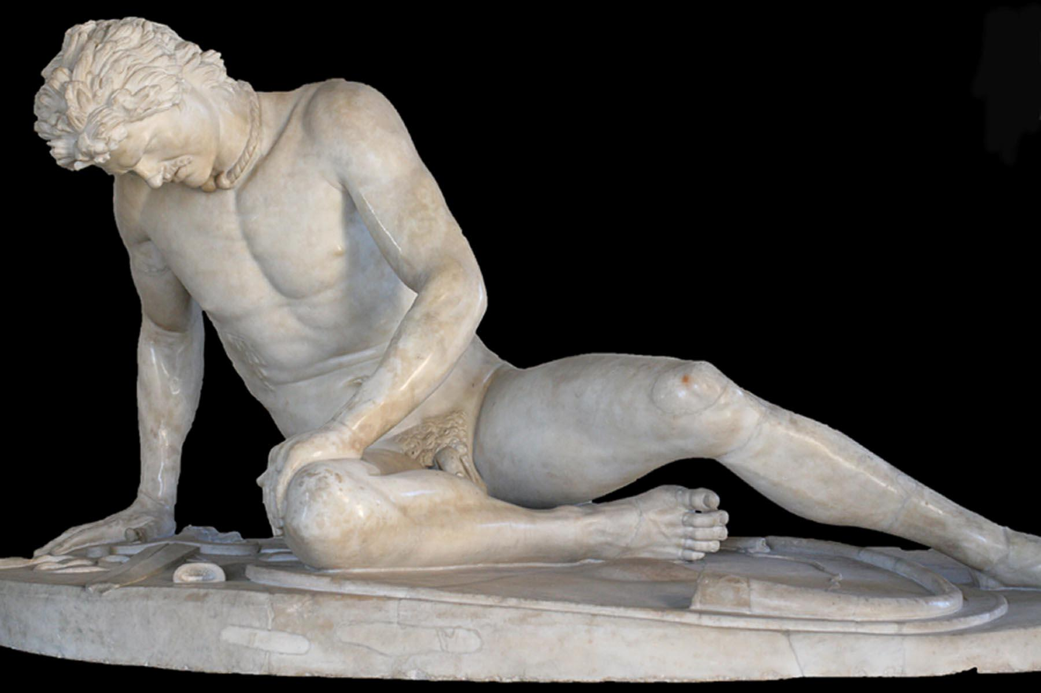
Romans & Celts
Mayhem Begins
Hannibal
Terrified the Romans
146 BCE
Julius Caesar Defeats the Gauls
51 BCE
Claudius
Annexes Britain
43 BCE
The Dying Gaul
Roman copy of a Greek statute dating between 200 -100 BCE
Greek Original dates from about 230 BCE
Commissioned by Attalus I of Pergamon to celebrate his victory over the Galatians -the Celts of Anatolia – originally from Gaul (Modern day France)
References to and details about Celts appear in at least 25 ancient sources

Slide 7
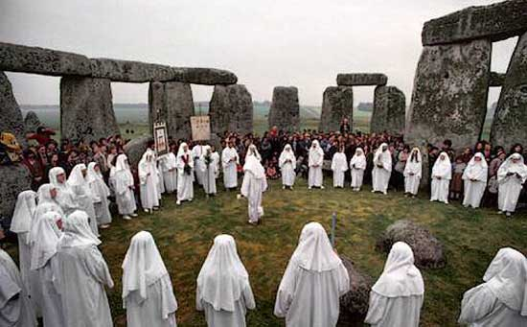
The Druids
A druid was a member of the high-ranking professional class in ancient Celtic cultures. While perhaps best remembered as religious leaders, they were also legal authorities, adjudicators, lore-keepers, medical professionals and political advisors. Wikipedia
Origins of the word
druid, druí ‘druid,- Insular Celtic meaning “sorcerer”
druídecht - Old Irish meaning “magic”
dryw – Welsh meaning “seer”
duw - Old Cornish meaning “seer”
4th century BCE - Druids first appear in the historical record
50s BCE – first detailed description of Druids written by Julius Caesar
1st century CE – Roman Emperors Tiberius and Claudius suppress the Druids
2nd Century CE- druidic social influence diminishes with rising power of paramount chieftains
7th - 8th CE law-texts suggest that the role of the druid in Irish society was reduced to that of a sorcerer who cast spells or performed healing magic.
Medieval Reappearance - after Ireland and Wales were Christianized, Christian monks wrote about the druids in propagandistic accounts of the lives of saints and stories.
Modern Druids - https://www.druidry.org/

Slide 8
Celts Attacked During the Renaissance
1568 Queen Elizabeth I issued a decree to ”rid Wales of numerous vagraunt and idle persons naming theim selfes mynstrelles, Rithmers, and Barthes”.
1603
Queen Elizabeth I ordered Lord Barrymore (Lord President of Munster, Ireland) "to hang the harpers wherever found, and destroy their instruments". Overnight revered harpers of Ireland went from being bards of Gaelic Irish life to criminals subject to immediate capital punishment.
In his preface to Irish Minstrels and Musicians, Chief Francis O'Neill states that Elizabeth's decree was the major factor in his work of collecting Irish music.
● Christianity supplanted the druids.
● The Vikings brought their theology.
● By the time of Tudor England, the druids had either disappeared or become priests. The Vetes had become magicians. The bards kept singing through it all!
1867 – The London Times
Eisteddfod - [Welsh Literary and Music Festival ] "is one of the most mischievous and selfish pieces of sentimentalism which could possibly be perpetrated. It is simply a foolish interference with the natural progress of civilization and property . . . The sooner all Welsh specialists disappear from the face of the earth, the better.”

Slide 9
The Modern Celts
Survival or Revival?
Edward Lhyud (Llwyd in Modern Welsh)
1660 – 1709 Welsh naturalist, botanist, linguist, geographer and antiquary
Lhyud's work is the basis of the modern concept of the Celts

Slide 10
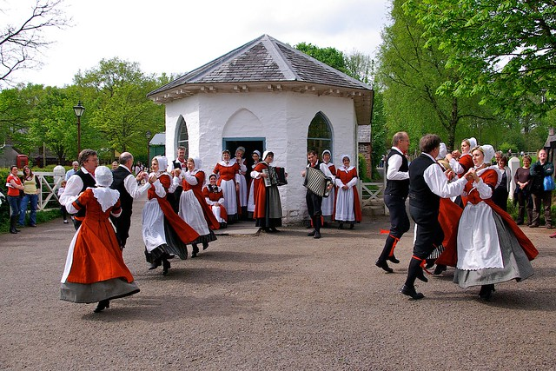
Music of Wales
Triple harp ● Male Choral Works ● Methodist hymnal
Only Unbroken Tradition of the Harp ● Lullabyes
E:\Celtic LECTURE\Videos\Welsh traditional dance at International students dinner - Swansea Univ.mp4
E:\Celtic LECTURE\Videos\Welsh Folk Dancing at The National Eisteddfod, Swansea 2006.mp4

Slide 11
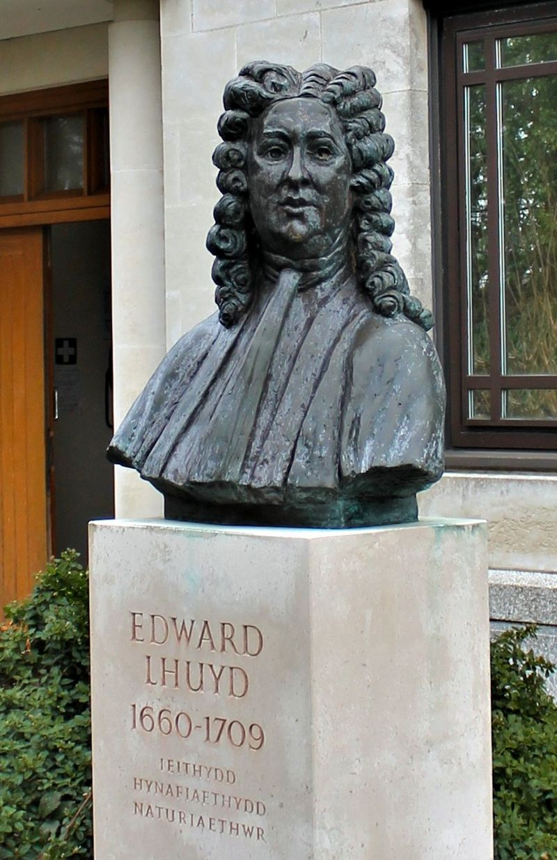
The Modern Celts are Created
1707 Treaty of Union `
England and Scotland become “Britain”
1707 Lhuyd publishes Archeologia Britania
Lhuyd's scholarship feeds a hunger for cultural identify and succor from the ravages of the Industrial Revolution.
“Celticism” comforts and dignifies those suffering in Britain and Ireland while providing meaning for the diaspora
“Celticism” is also a response to the perceived threats of Catholic France and Highland Jacobites
2001
The bronze bust of Lhuyd was unveiled by Dafydd Wigley, the former leader of Plaid Cymru, outside the University of Wales's Centre for Advanced Welsh and Celtic Studies in Aberystwyth, adjacent to the National Library of Wales.
Wikipedia

Slide 12
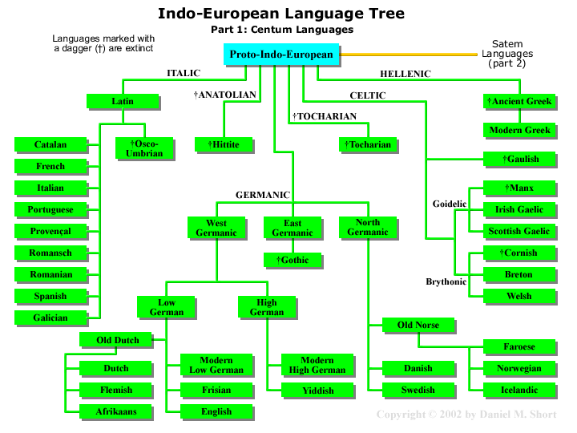

Slide 13
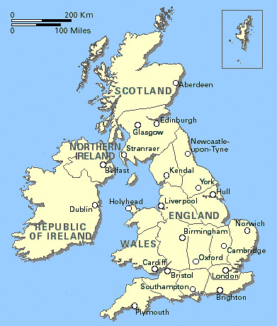
1800 -Acts of Union
Forcible extension of “The Union” to include Ireland
Non-English identities faced potential cultural oblivion through assimilation and submergence into a common Britishness which was overwhelmingly English in character.
Simon James
Durham University

Slide 14
King George IV to the Rescue!
1822
King George IV visits Scotland……..
He wears a kilt
That fashion statement ends an era of intense English repression of the Highland Scots
King George’s garb was intended to promote sales of English machine-woven cloth.
From this visit the entire modern (largely fabricated) notion of Scottish clan tartans evolved.
Capitalism overwhelms history
Celticness becomes fashionable

Slide 15
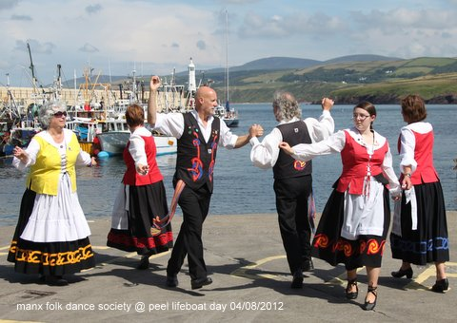
Music of Isle of Man
The BeeGees were born on the Isle of Man
Arrane Y Chlean - Sheep Under the Snow - Song of the Water Kelpie
E:\Celtic LECTURE\mp3\Manx Song Set.mp3

Slide 16
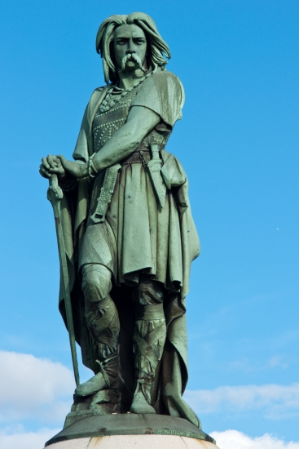
Embracing the Celts
Vercingetorix - 46 BCE
First national hero of France
1865 - Napoleon III erected the seven-meter-tall statue to commemorate Vercingetorix as a symbol of Gallic nationalism.
Queen Boadicea 60 BCE
Led a revolt against the Romans in Britain, Boudicca's forces destroyed Roman settlements and troops before being defeated.
Historians estimate that Roman forces killed 80,000 Celts
This 1903 statue sits on the banks of the Thames facing Parliament.

Slide 17
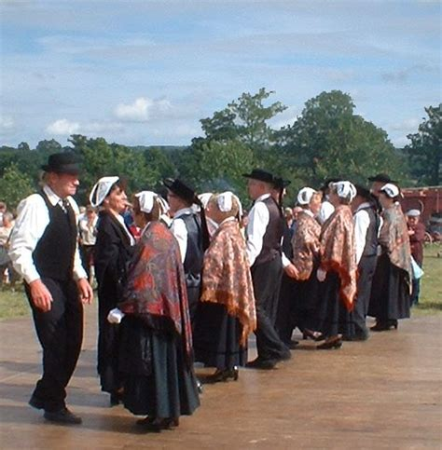
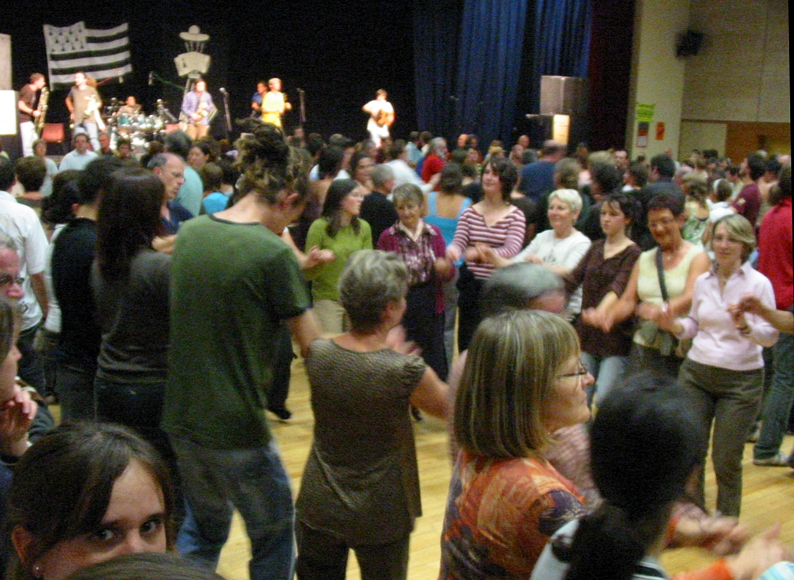
Music of Brittany
Ridee in 6 Temps
Ridee in 3 Temps
E:\Celtic LECTURE\mp3\Brittany Ridee Set.mp3
E:\Celtic LECTURE\Videos\Ridée 6 temps.mp4

Slide 18
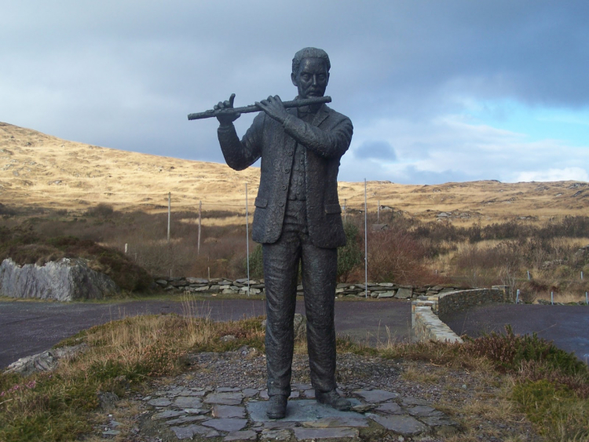
Saving Irish Music
Chief Francis O’Neill
1848 born near Bantry, County Cork.
1864 becomes a cabin boy on an English merchant vessel
1873 Becomes a Chicago policeman.
1901 to 1905 serves two Chicago mayors as Chief of Police
Recruits many traditional Irish musicians into the police force, including Patrick O'Mahony, James O'Neill, Bernard Delaney, John McFadden and James Early
1905 retires from the police force devotes his life to collecting and publishing traditional Irish Dance Music
1936 Dies in Chicago
“...the greatest individual influence on the evolution of Irish traditional dance music in the twentieth century"
biographer Nicholas Carolan

Slide 19
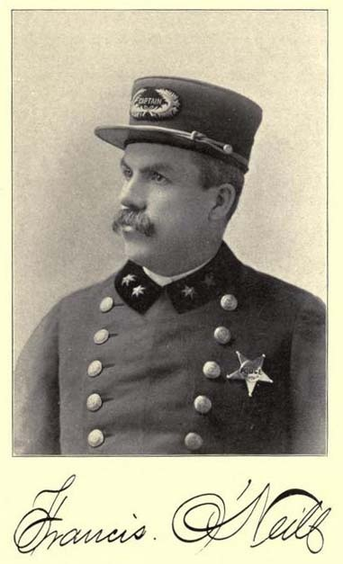
Saving Irish Music
Chief Francis O’Neill
1903 O'Neill's Music of Ireland 1,850 tunes
1907 The Dance Music of Ireland "O'Neill's 1001"
1910 Irish Folk Music: A Fascinating Hobby
including O'Farrells Treatise and Instructions on the Irish Pipes, publishes 1797-1800 and Hints to Amateur Pipers by Patrick J. Touhy.
1913 Irish Minstrels and Musicians biographies of musicians, including those from whom he collected tunes in Chicago.
1915 400 tunes arranged for piano and violin
1922 Waifs and Strays of Gaelic Melody 365 tunes
More than 3,600 Traditional Irish Melodies
“...the greatest individual influence on the evolution of Irish traditional dance music in the twentieth century"
biographer Nicholas Carolan

Slide 20
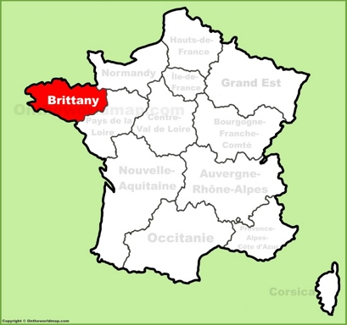
Three Part Acid Test of “Celtdom”
1. Did ancient peoples of the region call themselves “Celts”?
2. Did ancient authors call those same people “Celts”?
3. Has a Celtic language been spoken continuously in the region from ancient to modern times?
Brittany
the only modern region that qualifies as a truly Celtic Region.

Slide 21
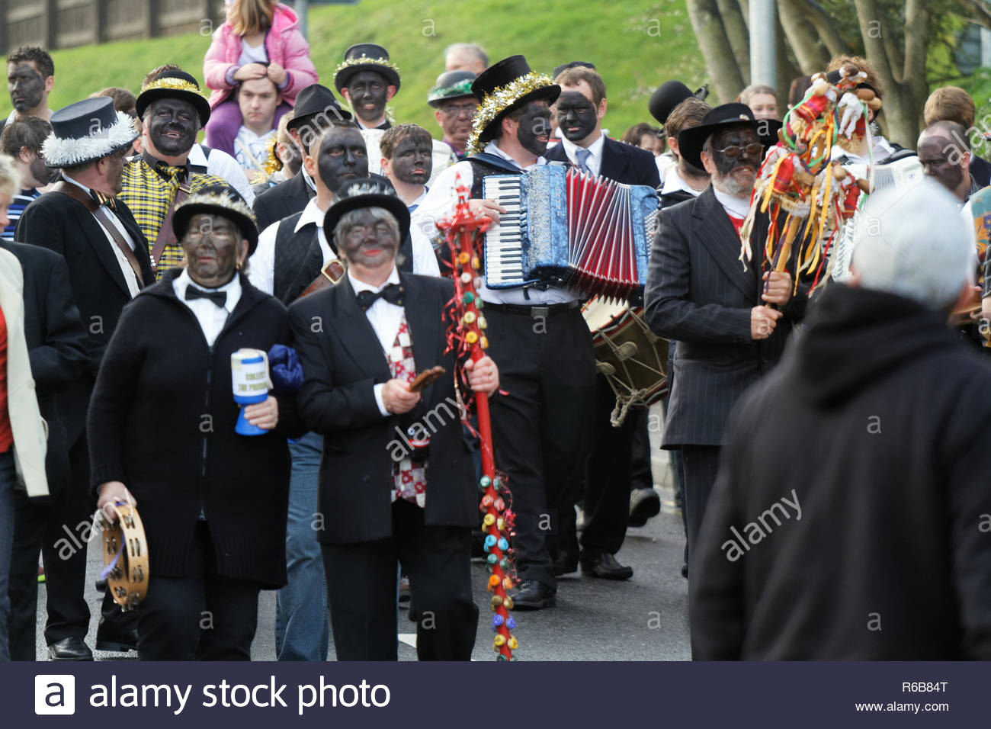
Music of Cornwall -Chirstmas Carols
Cornwall & Charles Dickens
Dickens frequently visited Cornwall and used many landscape features there to describe the setting of his novel A Christmas Carol.
On St Patrick's Day 1842, at 11 Cork Street, Westminster, London, Dr Miles Marley invited guests over to celebrate – one of those guests was Charles Dickens.
A newspaper article reporting on the dinner stated that “Dickens had started a discussion over unusual names and it was agreed that Marley was indeed an unusual name. It was said that Dickens told Marley, 'by the end of the year your name will be a household word'”.
A Christmas Carol was published in 1843 and sold 6,000 copies in that year
E:\Celtic LECTURE\mp3\Cornwall Reel Set s Water - Window.mp3

Slide 22
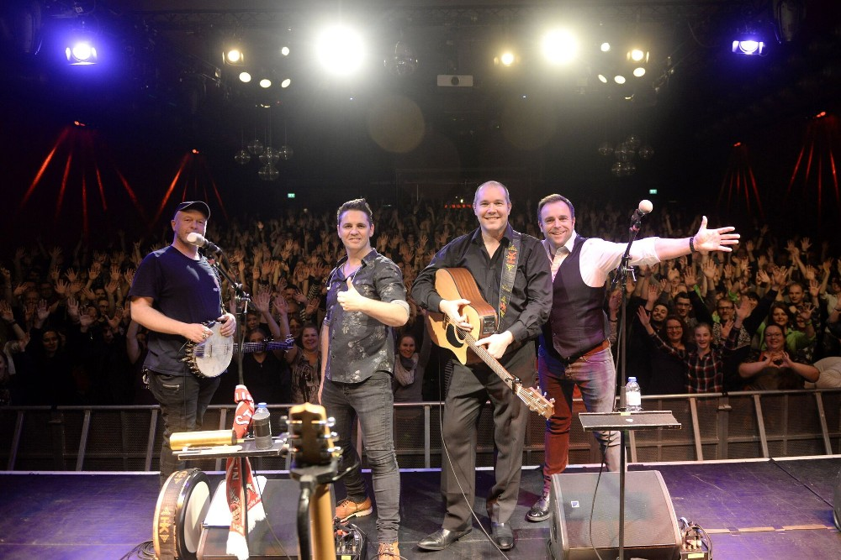
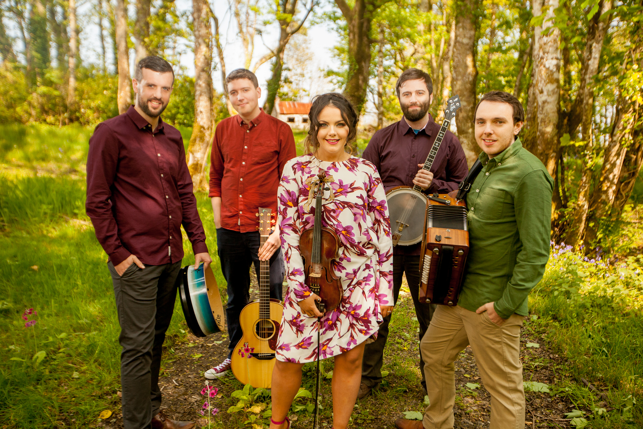
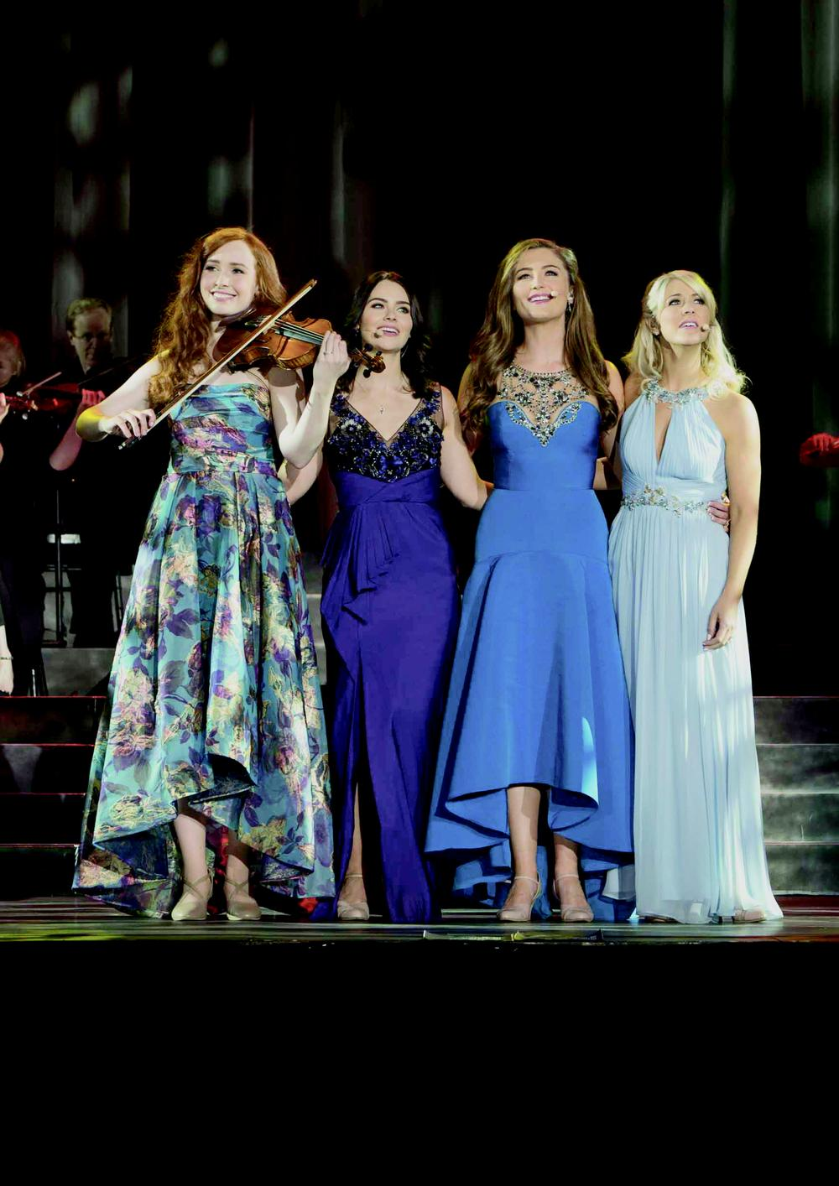
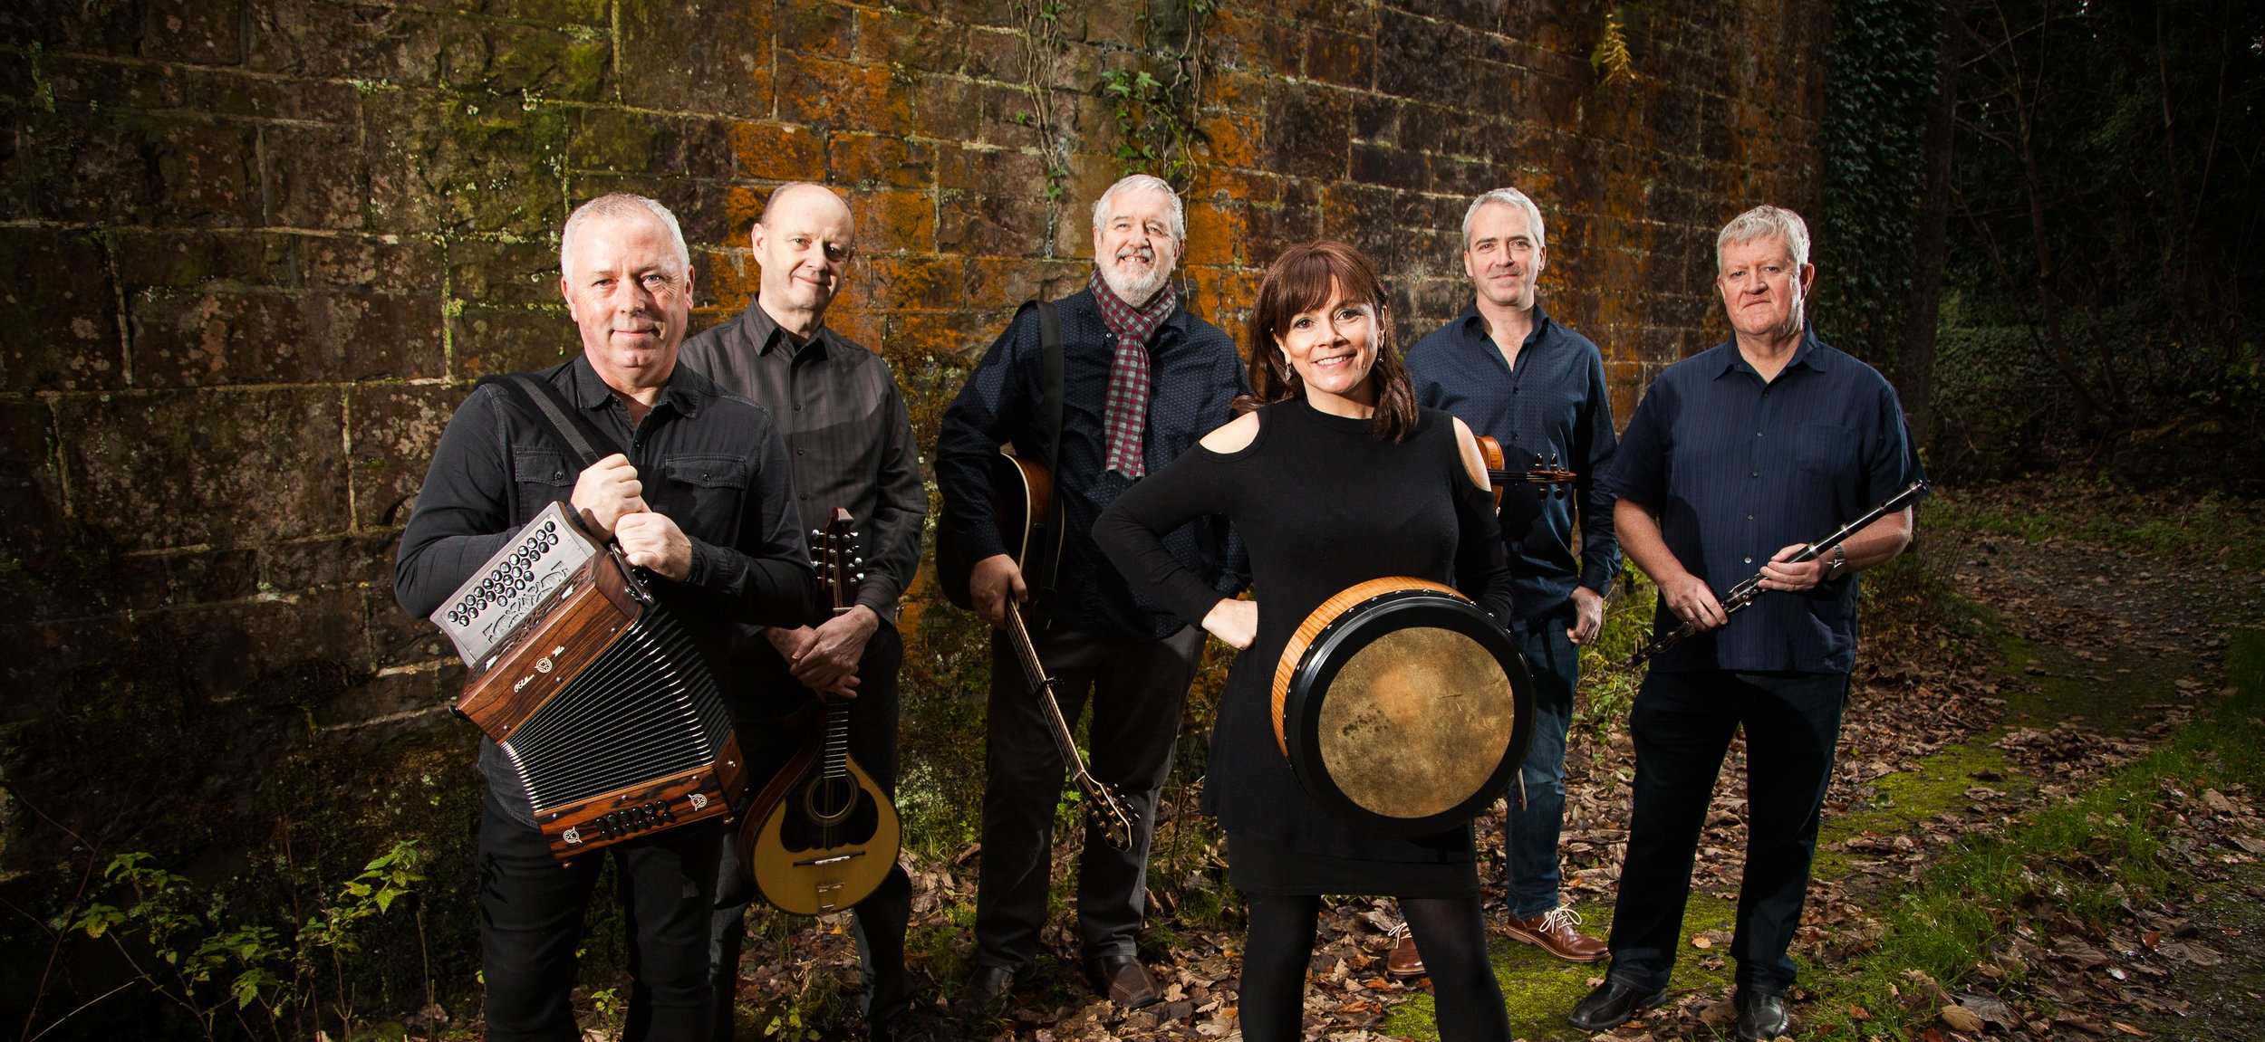
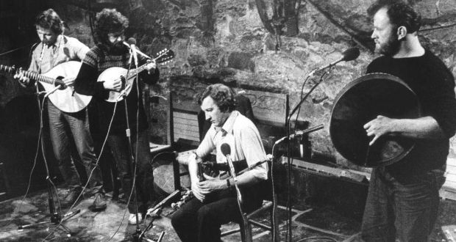
The Contemporary Celts
Post WWII

Slide 23
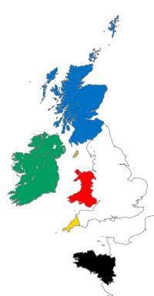
The Six Celtic Nations
● Brittany
● Cornwall
● Ireland
● Isle of Man
● Scotland
● Wales

Slide 24
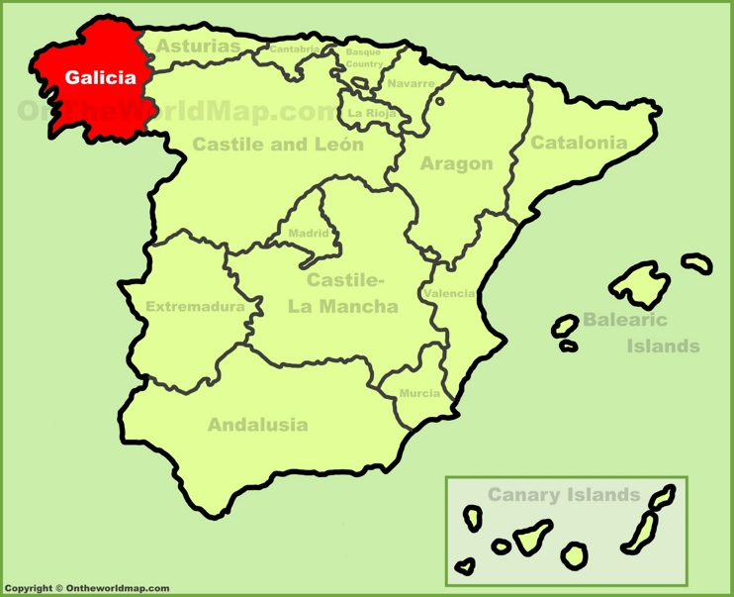
What about Galicia???
For a discussion of “the Galician Question” visit this link:
https://www.billtroxler.com/galicia.html

Slide 25
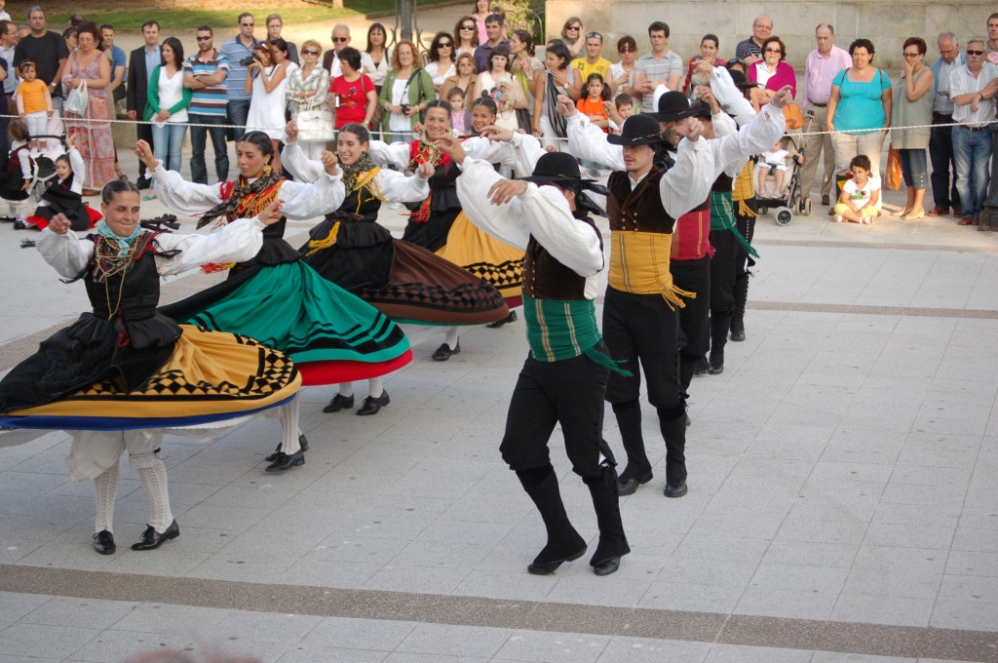
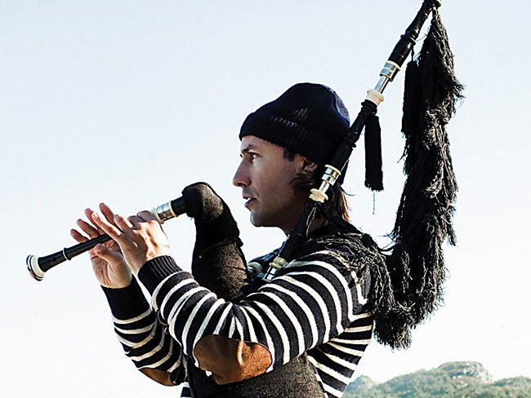
Music of Galicia
Carlos Núñez is the foremost advocate for Galician music. He plays the gaita, Galician flute, ocarina, Irish flute, whistle, and low whistle.
Núñez is noted for exciting performances and working with large groups of musicians
E:\Celtic LECTURE\Videos\Banda de Gaites de Llacín - Aires de Pontevedra (Direutu, directo, live).mp4

Slide 26
Political Celts
1902 Celtic Congress
The International Celtic Congress was founded to promote the knowledge, use, and appreciation of the languages and cultures of the six Celtic countries. National Branches of the Congress meet in an International Congress each year in order to help further these aims.

Slide 27
Political Celts
1961 Celtic League
The aim of the Celtic League is to contribute to the struggles of the six Celtic nations to secure or win their political, cultural, social and economic freedom. This includes:
 Fostering co-operation between Celtic peoples.
 Developing the consciousness of the special relationship and solidarity between them.
 Making our national struggles and achievements better known abroad.
 Campaigning for a formal association of Celtic nations to take place once two or more of them have achieved self-government.
 Advocating the use of the national resources of each of the Celtic countries for the benefit of all its people.

Slide 28
Celtic Politics
Wales - Plaid Cymru
A social-democratic political party in Wales advocating for Welsh independence from the United Kingdom within the European Union. Wikipedia
4 of 40 Welsh seats in the UK House of Commons
1 of 777 seats in UK House of Lords
10 seats of 60 in the National Assembly for Wales
1 of 4 Welsh seats in the European Union Parliament
https://www.partyof.wales/
Scotland -SNP
The Scottish National Party is a Scottish nationalist and social-democratic political party in Scotland. The SNP supports and campaigns for Scottish independence. Wikipedia
https://www.snp.org/
35 of 39 Scottish seats in UK House of Commons
2 of 6 Scottish seats in European Parliament
62 of 129 seats in Scottish Parliament

Slide 29
Are You a Celt?
What is not in doubt, as anyone familiar with Galicia, Brittany, Ireland, Scotland, or Wales will well know, is the very strong emotional appeal with the idea of sharing a common Celtic heritage has. Perhaps the only real definition of a Celt, now as in the past, is that Celt is a person who believes him or herself to be Celtic.
Barry Cunliffe
Iron Age Scholar
Oxford University

Slide 30
A Celtic Closer
If you visit Brittany, Cornwall, Wales and enjoy a grand meal at an expensive restaurant, at the close of the evening when the bill is presented, point to the person next to you, smile broadly and confidently say:
An den ma a be oll
This gentleman will pay for everything
Drochmholadh a dhíbirt !!!
Banish Misfortune

